Slide 1


ECEN 403 Final Presentation Project name: Kubernetes-based Attacks Team members: Albert M, Patrick C, Thomas
Team sponsor: Dr. Sandip Roy

Slide 2
Problem Statement
The US Navy is using Kubernetes to manage software. However, as a relatively new cyberservice, Kubernetes has a variety of cyber security weaknesses.

Slide 3
Proposal
Develop a scalable Kubernetes testbed that can simulate and collect the data of common types of attacks.

Slide 4
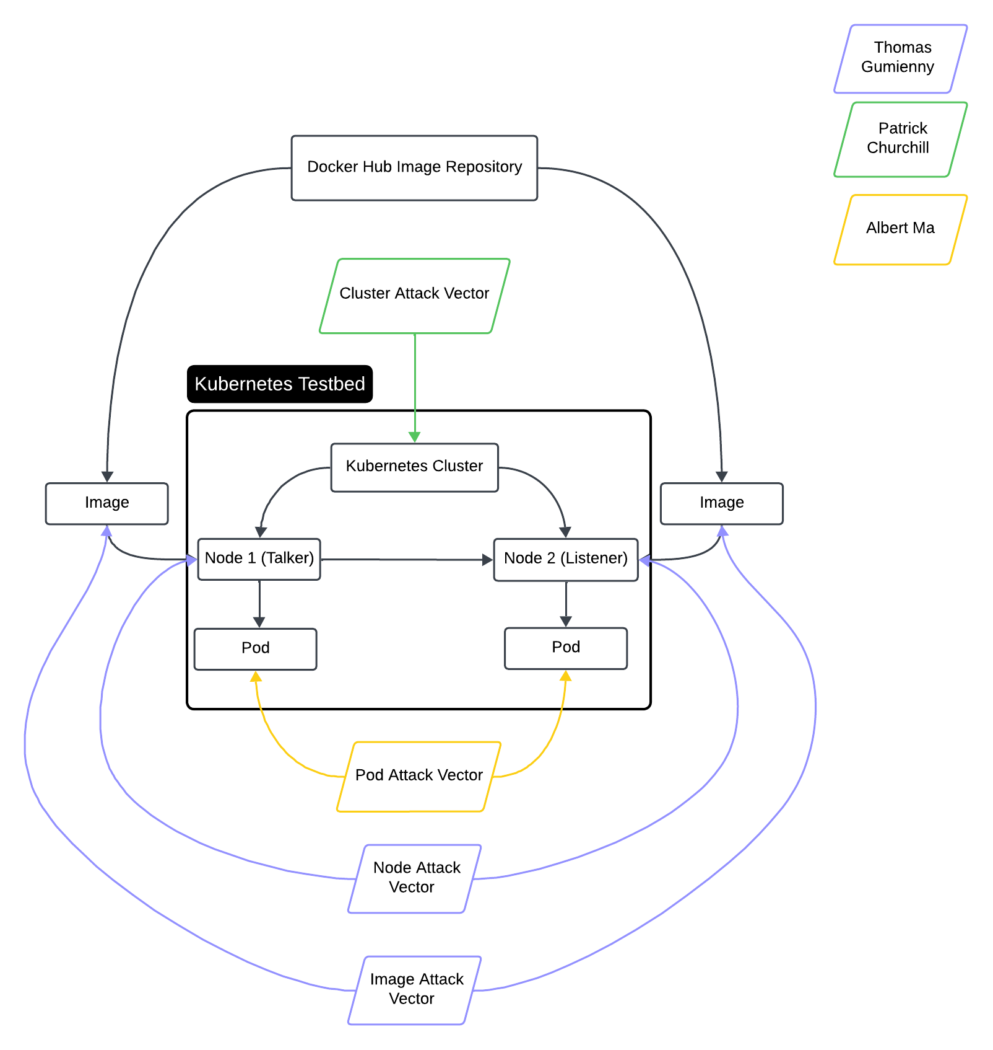
Diagram of Subsystems and Interfaces

Slide 5
Cluster Setup
Team Project
Accomplishments since the last presentation | To-Do
-Nodes are communicating with each other -Vulnerable pods and images deployed to cluster -Local registry to store malicious image created | (404) Make the cluster more of an ecosystem (404) Make attacks executable via script (404) Collect attack data (kubeshark)

Slide 6
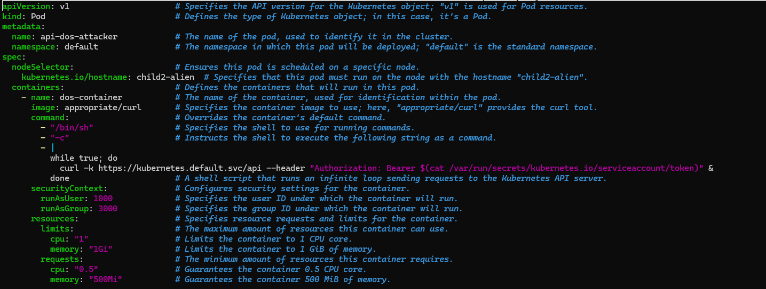
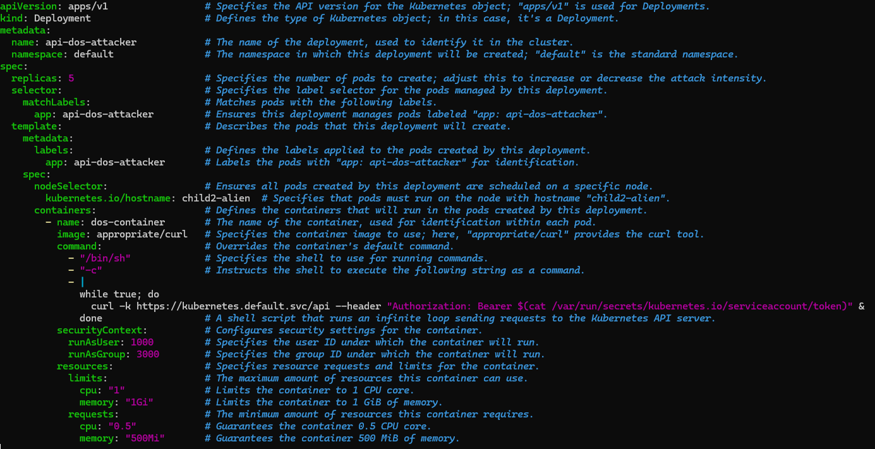
Cluster Attack
Patrick Churchill
Attack Overview
Small Denial of Service(DOS) pods
Does not get recognized by cluster
Increase amount of pods
Overload agent node and crash node

Slide 7
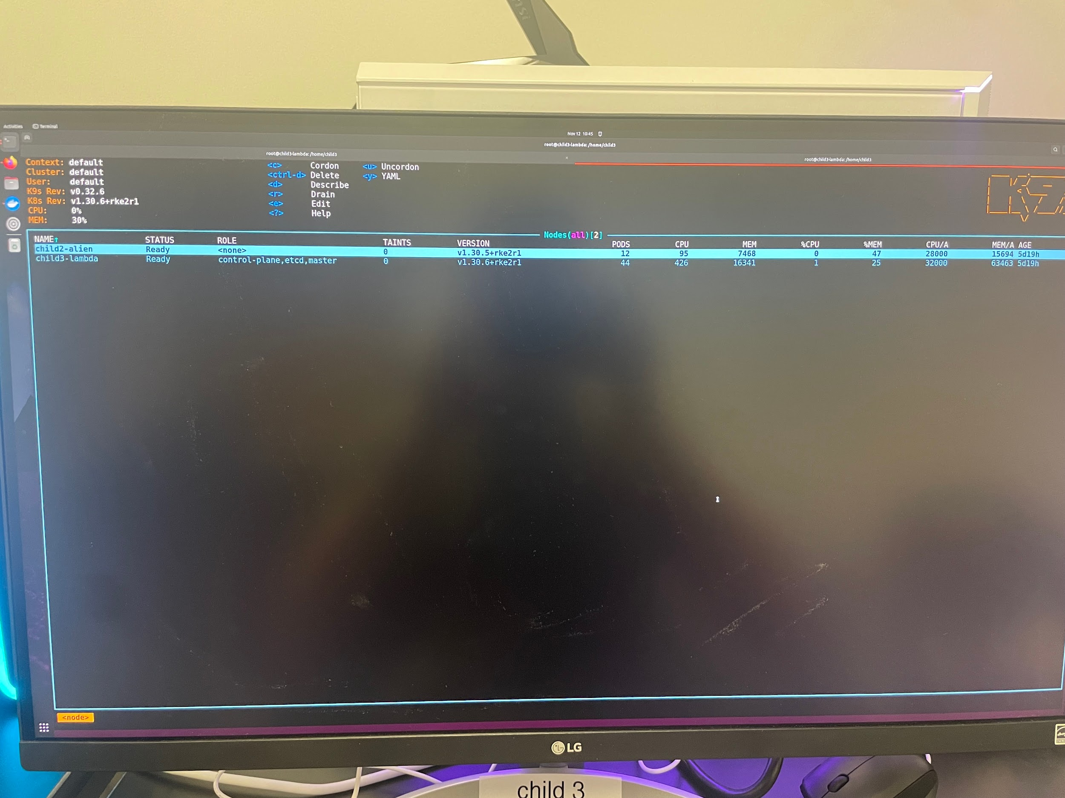
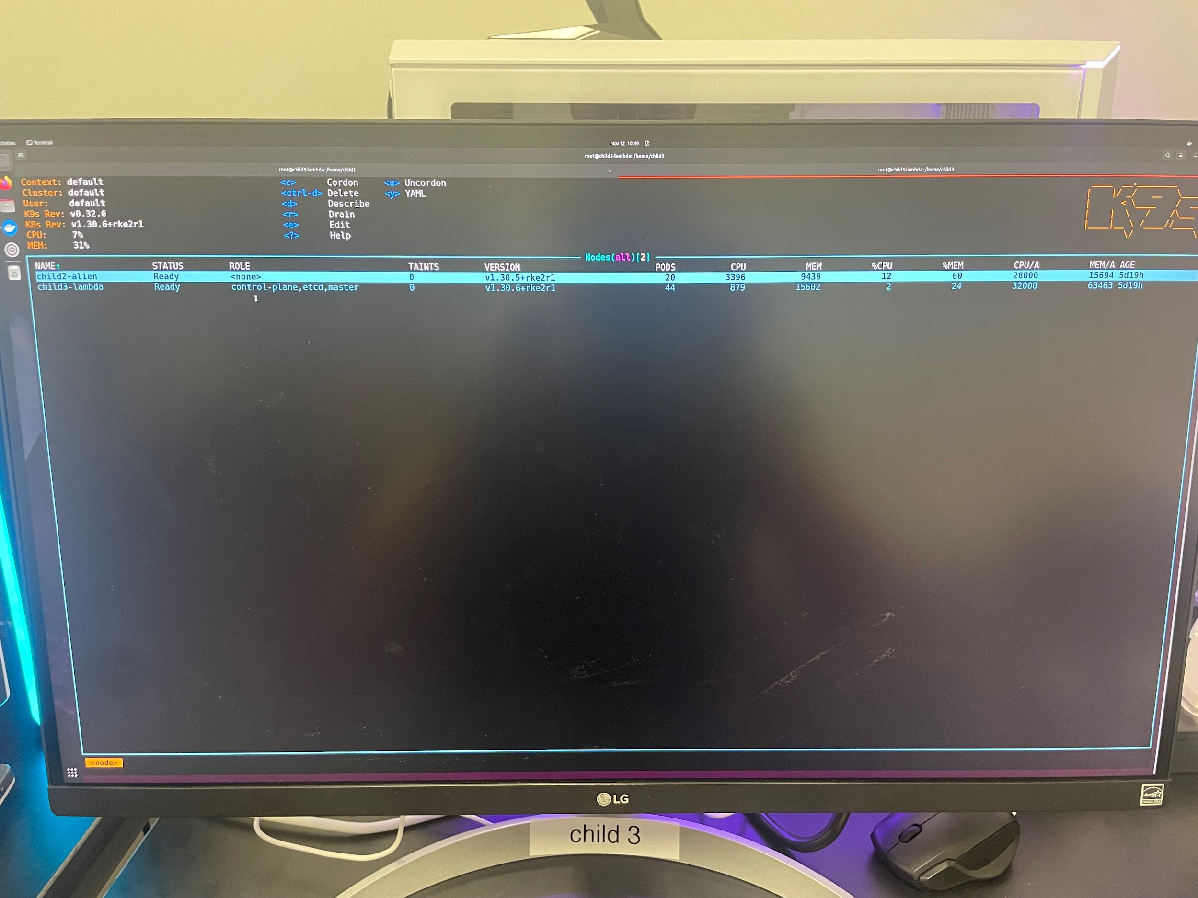
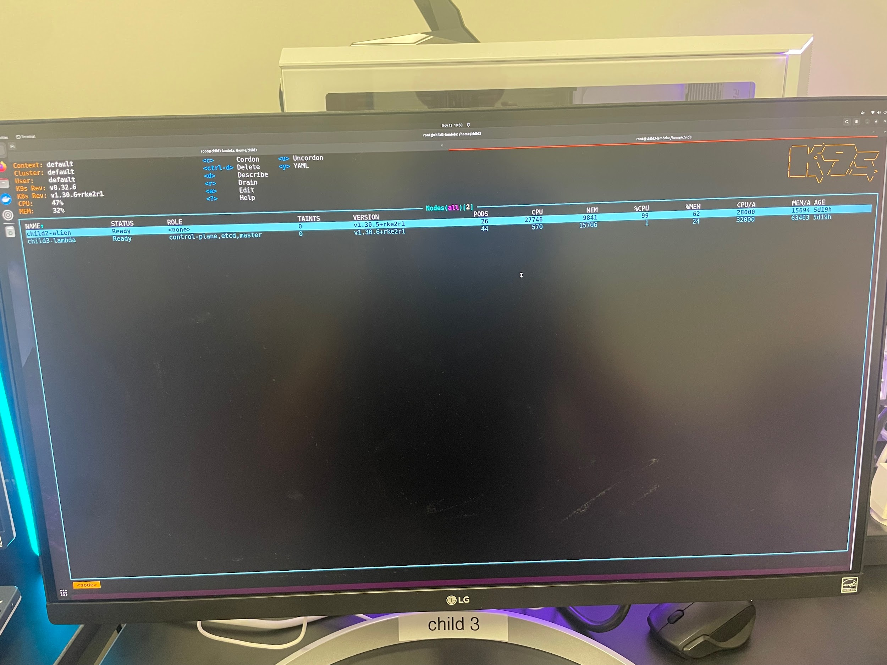
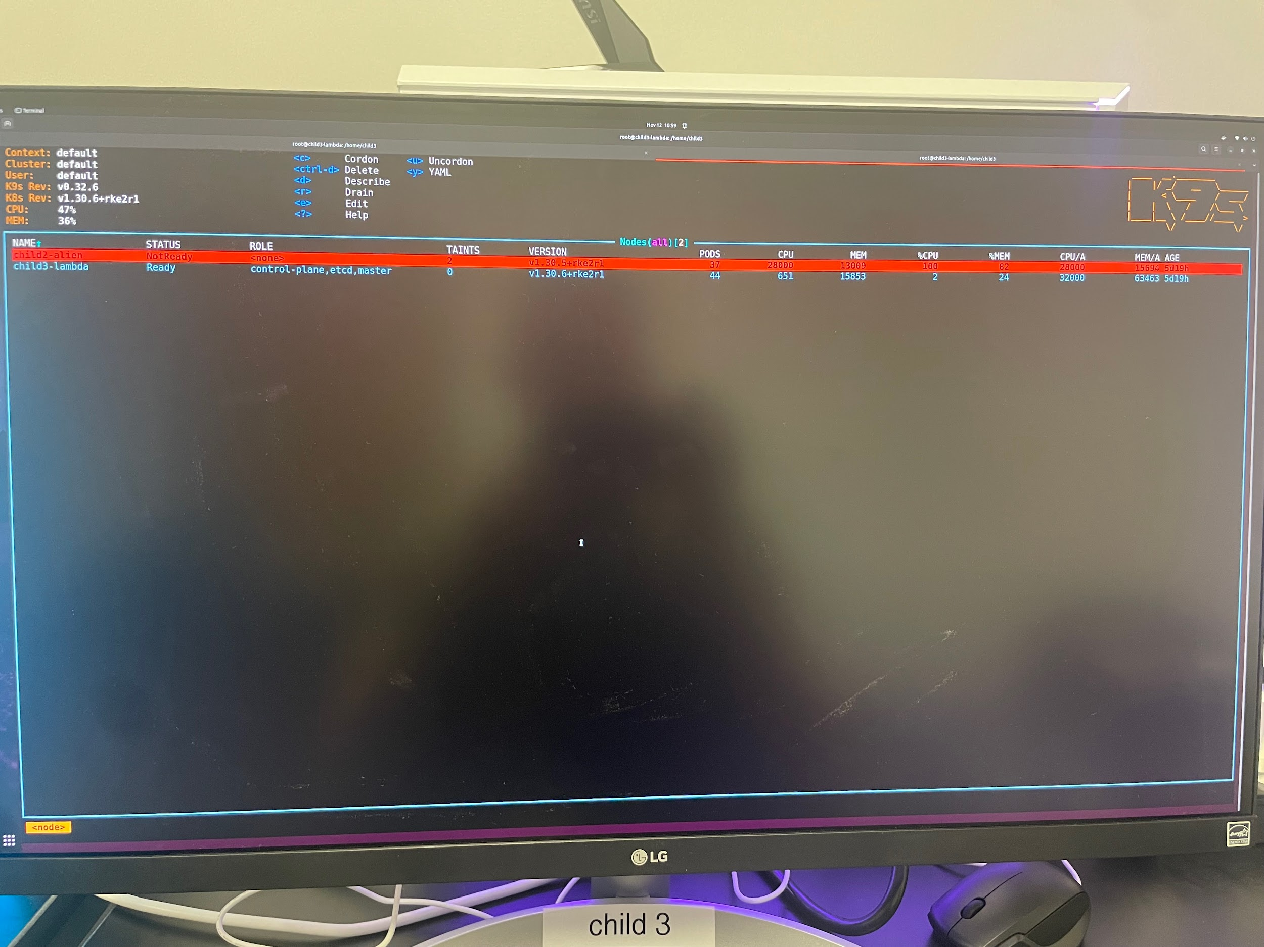
2 Attack Pods
10 Attack Pods
16 Attack Pods
27 Attack Pods

Slide 8
Validation
Test | Status
Small Attacker Pod is able to partially fill CPU and Memory of Agent node | [SUCCESSFUL]
Multiple Attacker Pods can crash the Agent Node | [SUCCESSFUL]

Slide 9
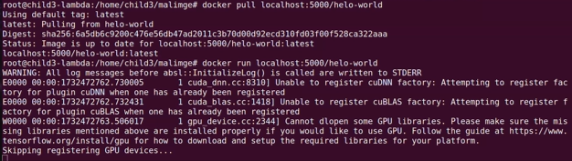
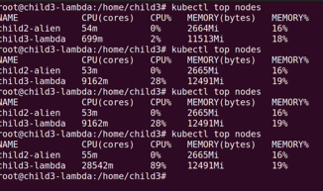
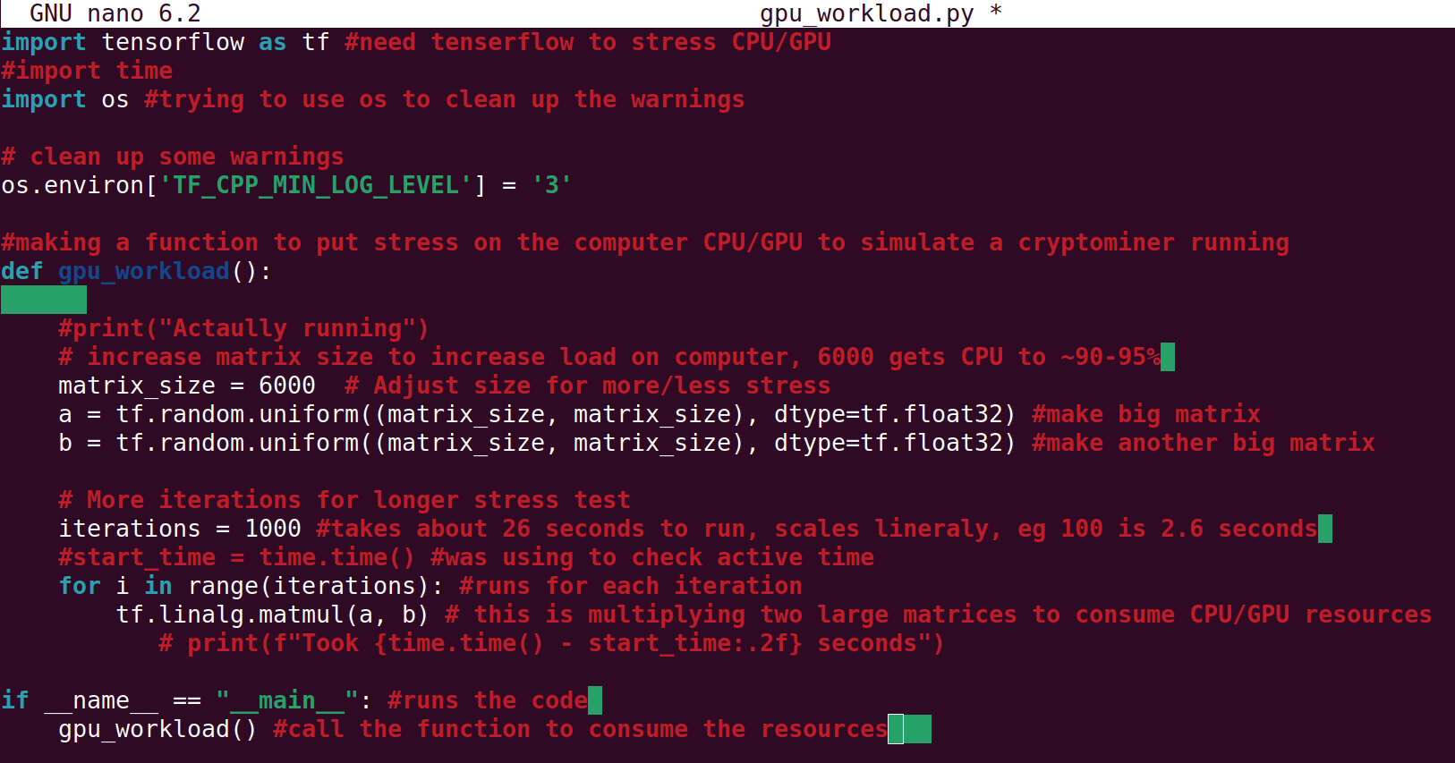
Image Attack
Attack Overview
Image with similar name to commonly pulled docker image with malware
When ran, image consumes significant amount of CPU to represent a cryptominer being ran

Slide 10
Validation
Test | Status
Image simulates cryptominer | [SUCCESSFUL]

Slide 11
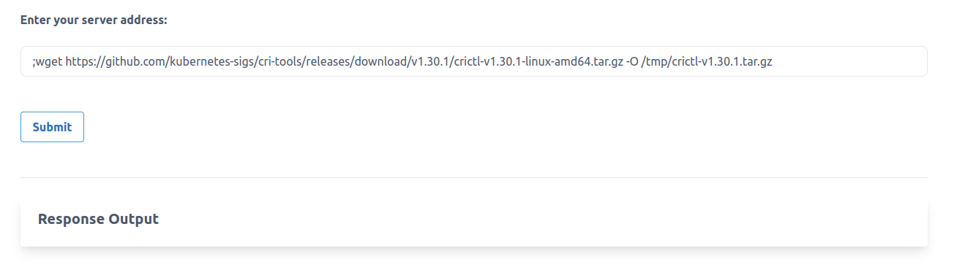
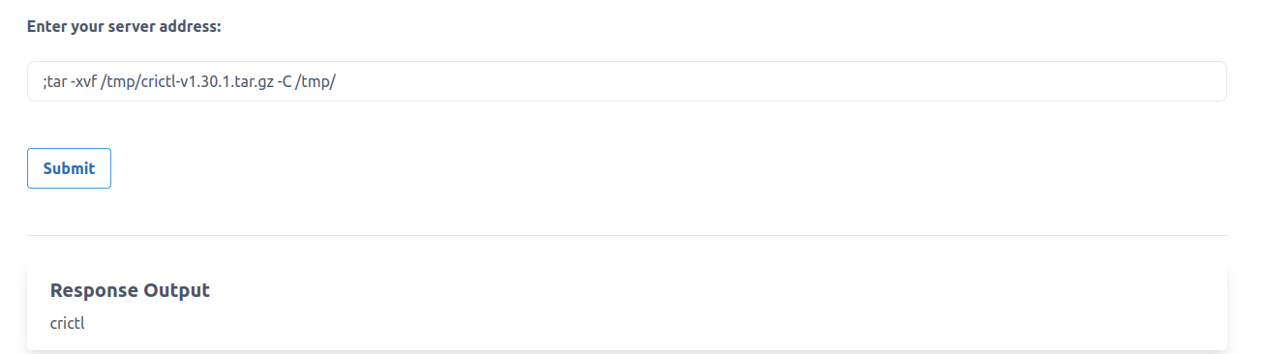
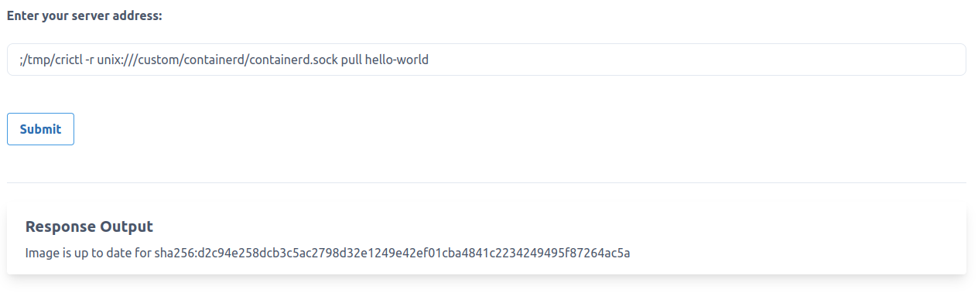
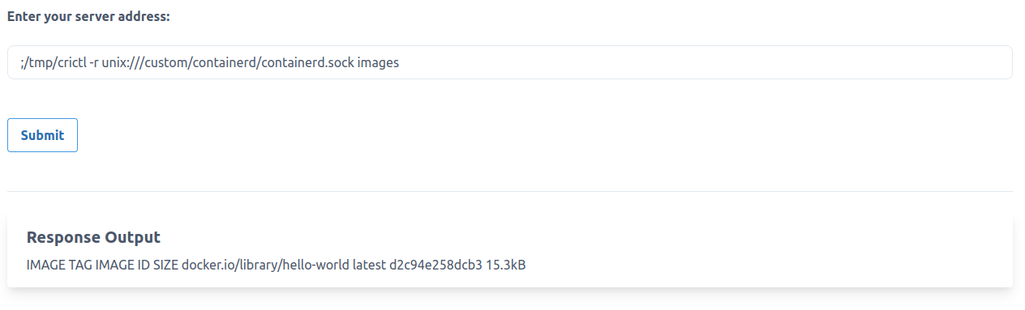
Node Attack
Attack Overview
Use external command prompt and root access to install crictl
use crictl to pull images and run pods at will
To - Do
Use crictl to run Patrick’s DoS container
crictl is only displaying images, but not pods

Slide 12
Validation
Test | Status
Can access node level control from outside the node | [SUCCESSFUL]
Can start/stop running pods | [TESTING]
Can pull from docker | [SUCCESSFUL]

Slide 13
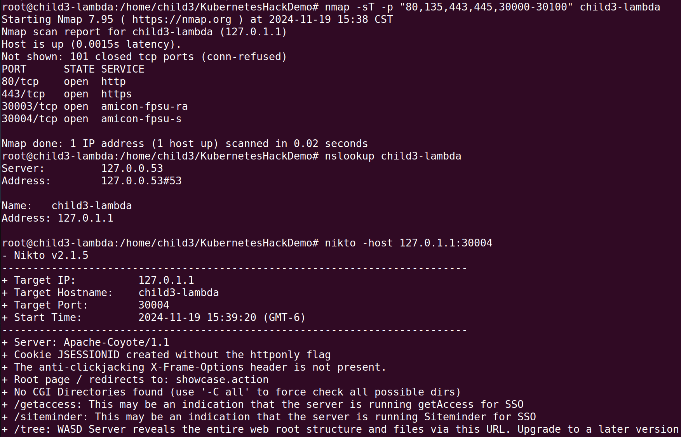
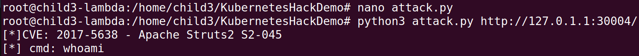
Pod Attack
Albert Ma
Sniffing for open ports
Attack Overview
Create attack container and target pod
Attack container conducts reconnaissance on network for open ports
Execute commands on target
Gain reverse shell access to target pod
To Do
Use reverse shell access to create a hijacked image
Create a patch to the attack
All vulnerabilities on target IP
Attack execution (reveals details of target)

Slide 14
Validation
Test | Status
Attack Reconnaissance can display all open ports in the network | [SUCCESSFUL]
Can execute attack commands toward targets (using their IP address) | [SUCCESSFUL]
Can gain reverse shell access in target | [TESTING]

Slide 15
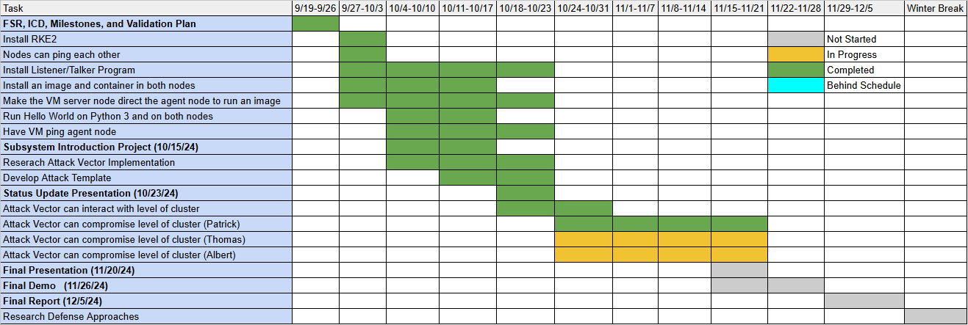
Validation Status

